Slide 1
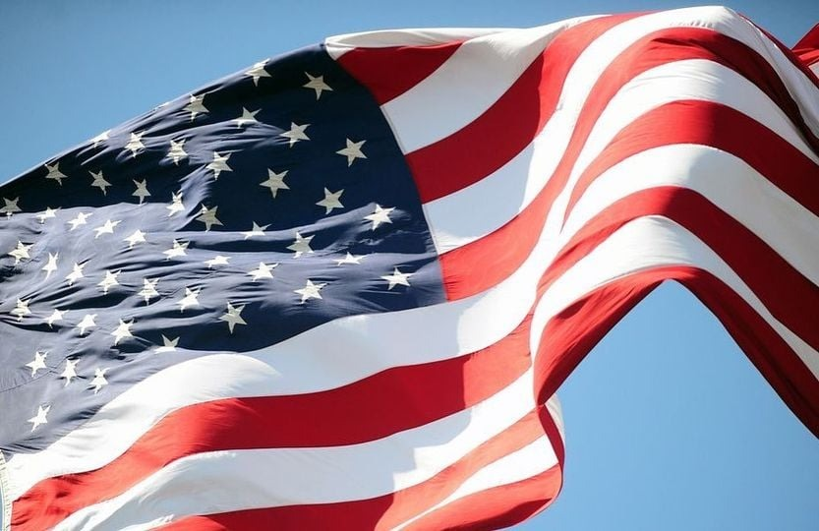
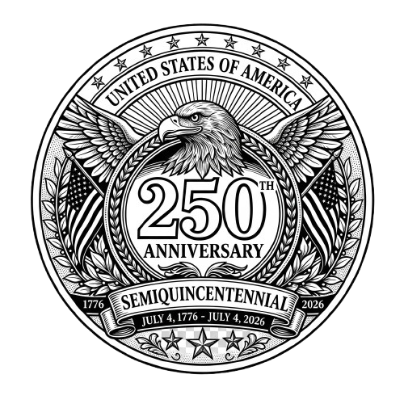
American Principles of Freedom
Notes:
Welcome, everyone! Today we are talking about why the founding of the United States isn't just a history lesson—it’s also spiritual. We are celebrating the 250th anniversary of a nation that was built on the idea that you were born to be free.

Slide 2
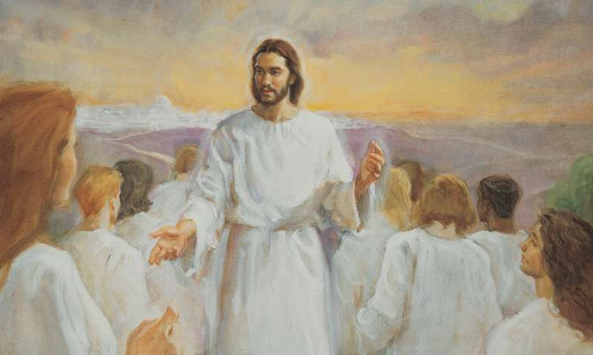
God’s Plan of Happiness
  Before the world was created, God gave us the right to choose.
  Jesus Christ made it possible through His sacrifice.
  Satan wants to destroy our right to choose.

Slide 3
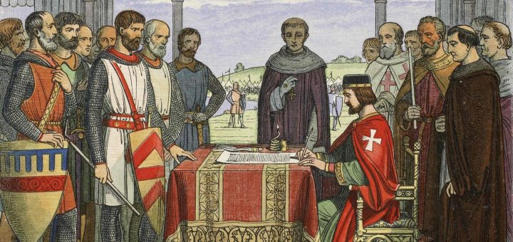
The Story of Freedom
Magna Carta (1215): No one is above the law.

Slide 4
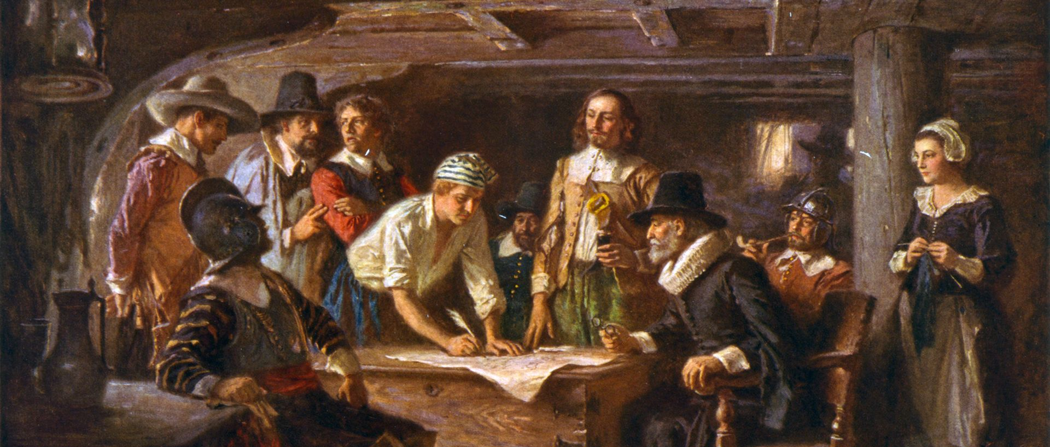
The Story of Freedom
Pilgrims (1600s): Wanted religious liberty and self-government.

Slide 5
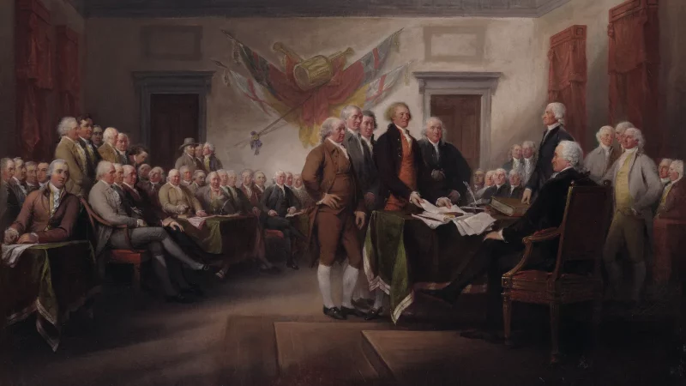
1776
DECLARATION OF
INDEPENDENCE
The Lord said,
“I established the Constitution of this land, by the hands of wise men whom
I raised up unto this very purpose...”
(Doctrine and Covenants 101:80)
250
YEARS
AGO

Slide 6
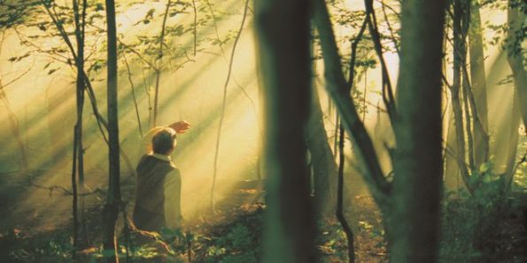
1820
RESTORATION
OF THE GOSPEL
Without freedom of speech and religion, Joseph Smith couldn't have shared his vision or organized the Church

Slide 7
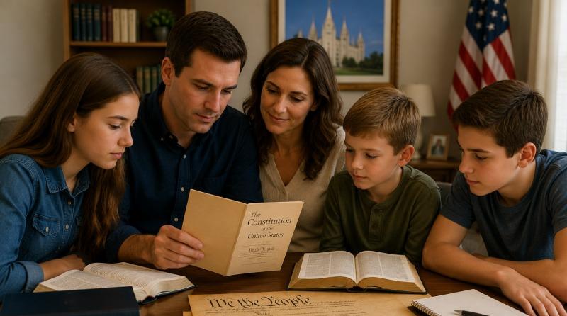
Family Proclamation
Learn to love and serve each another, keep the commandments, and obey the law.
We must strengthen the family as the basic unit of society.

Slide 8
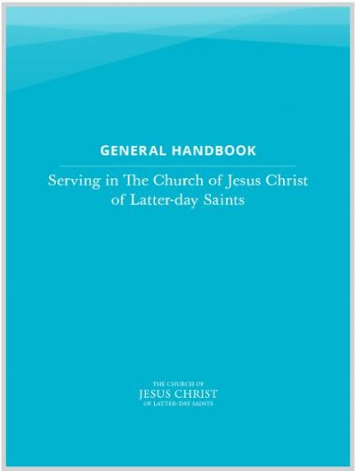
Register to vote and study issues and candidates carefully.
Vote for leaders who are honest, good, and wise.
The Church does not endorse any political party or candidate. Nor does it advise members how to vote.

Slide 9
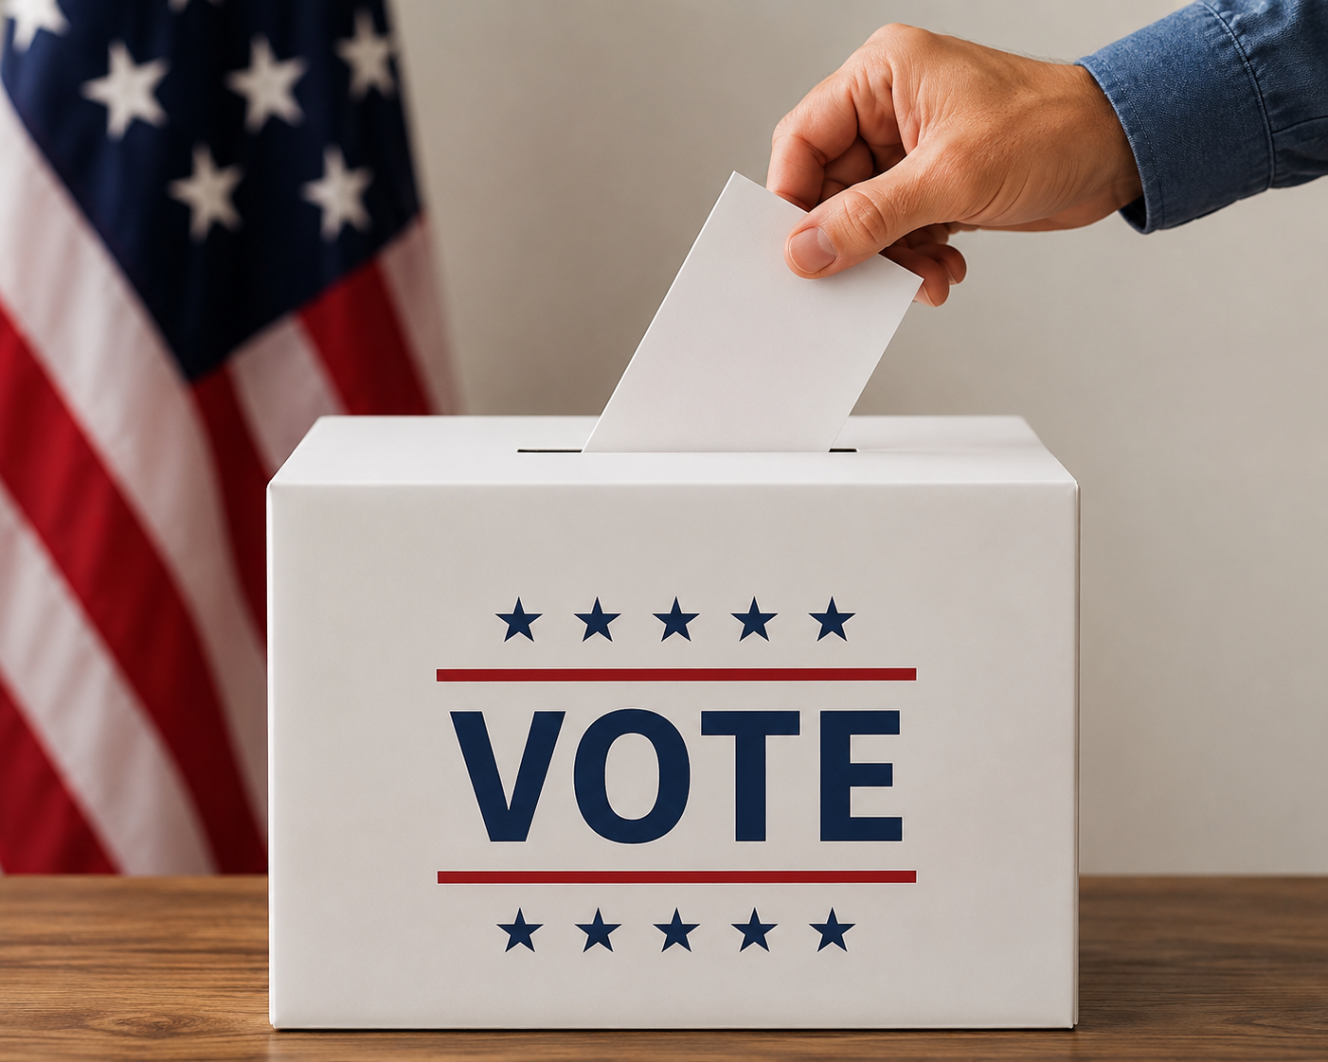
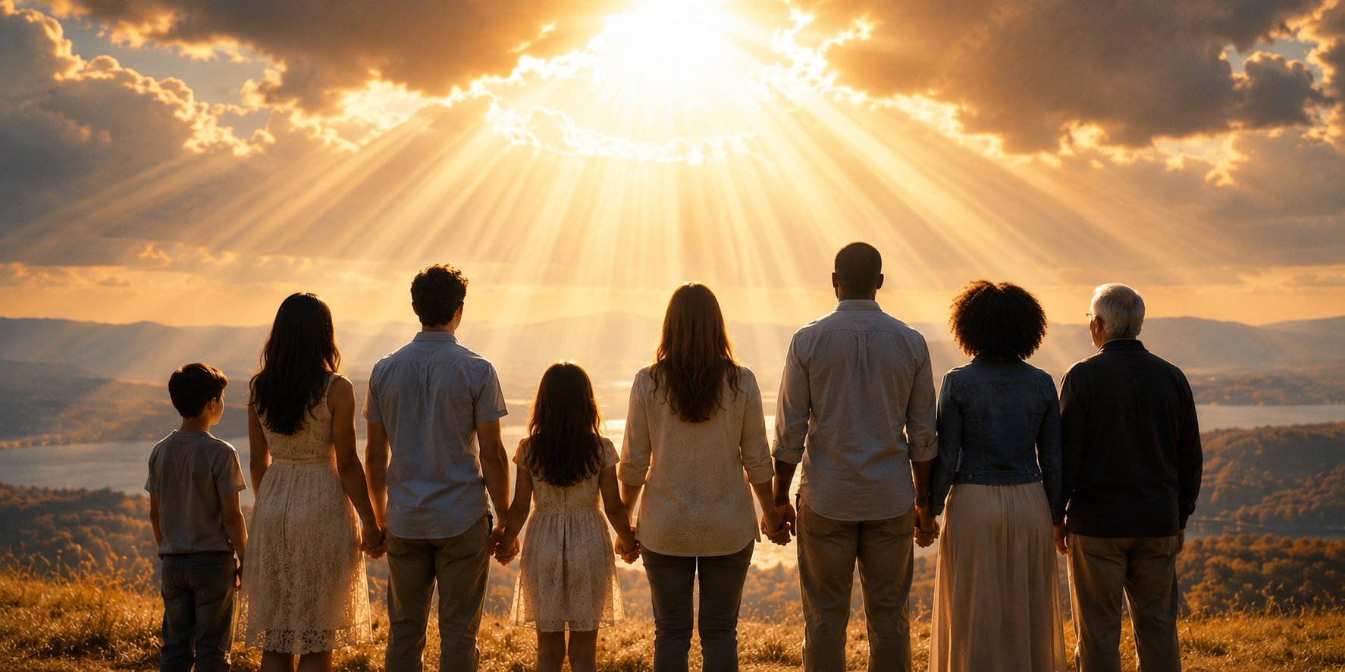
Principles That Protect Freedom
Government By the People
We vote for leaders to make decisions for us.
Rights Come from God
Rights are not granted by the government but come from God.

Slide 10
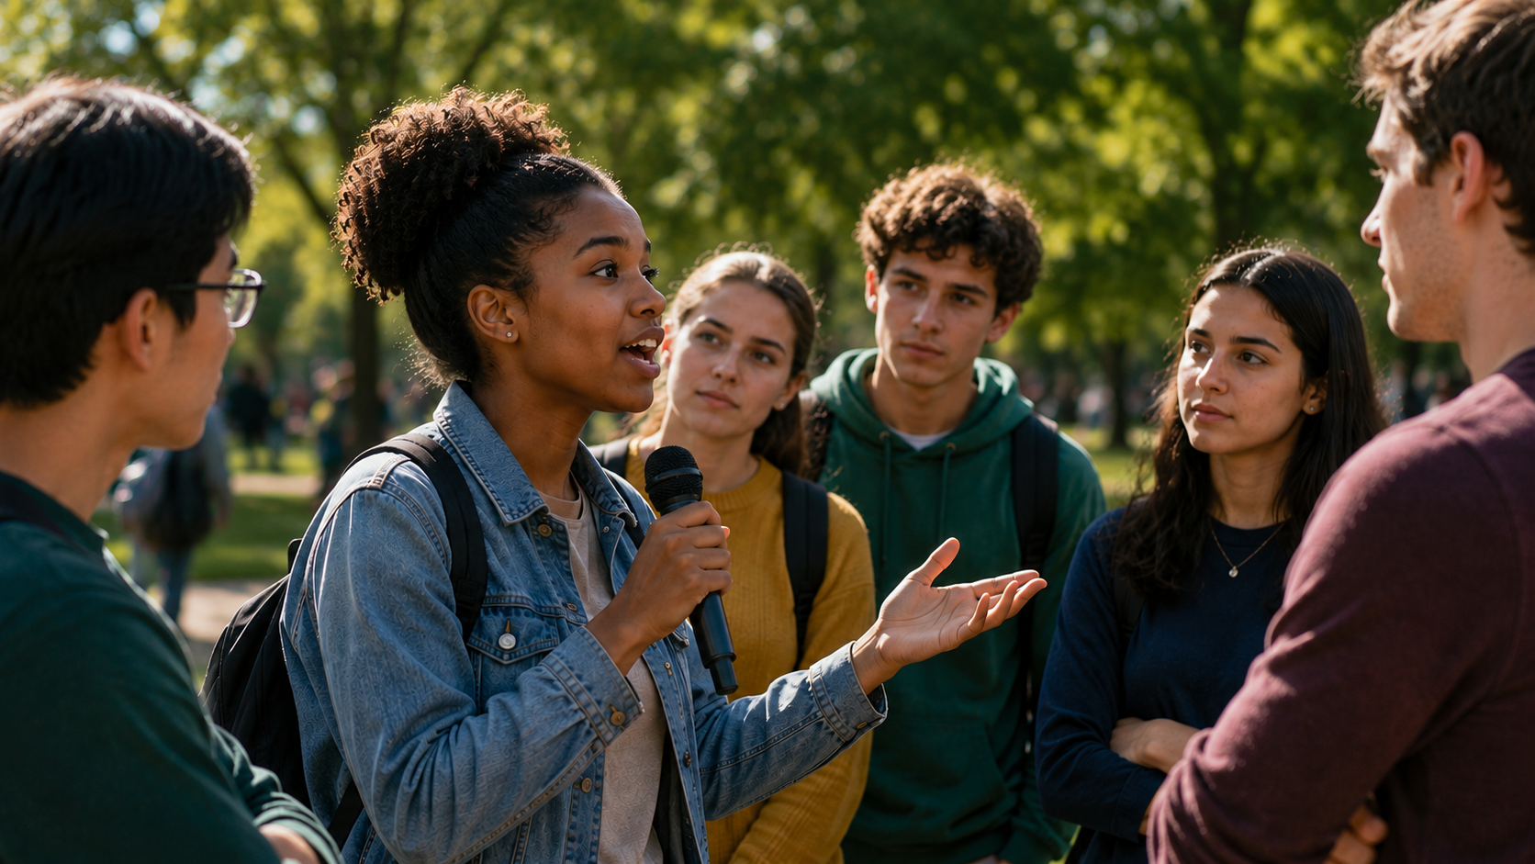

Principles That Protect Freedom
Freedom of Speech
The right to say what you believe.
Freedom of Association
The right to gather in groups, like churches and organizations, to work toward shared goals.

Slide 11
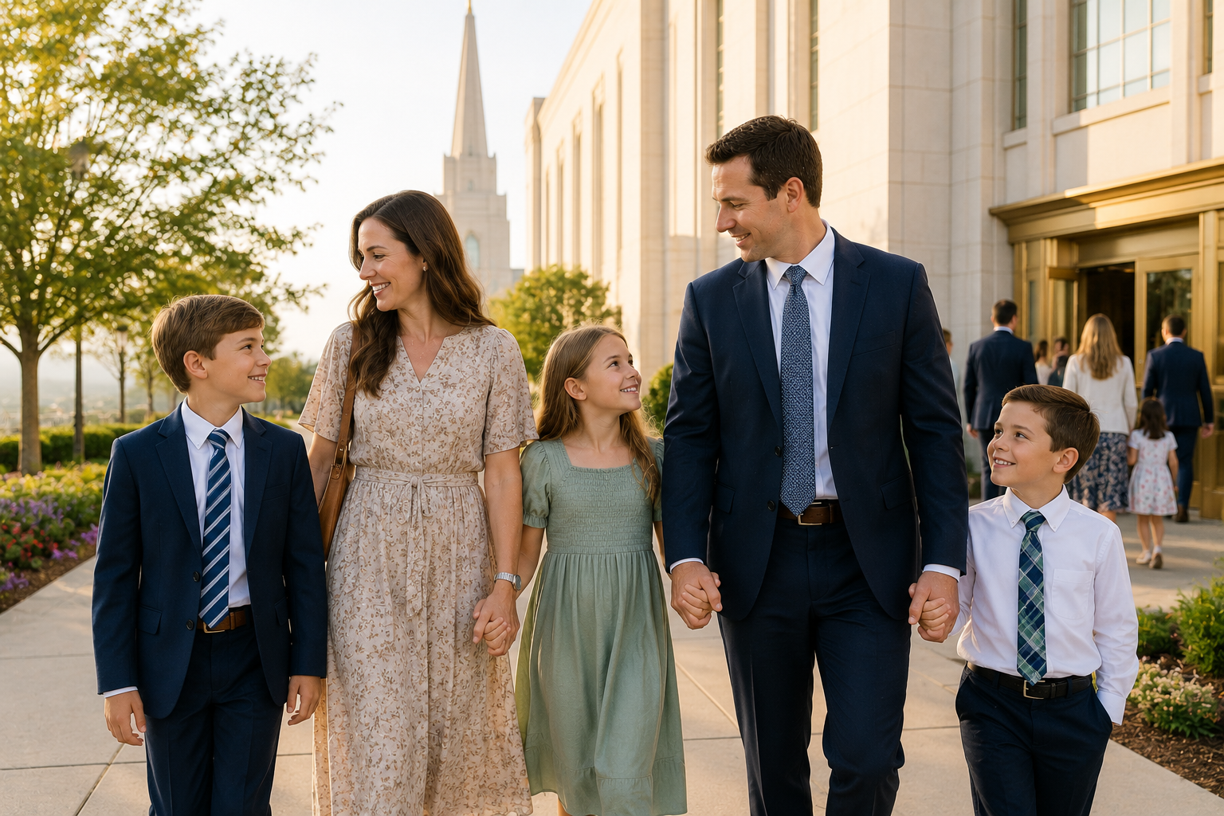
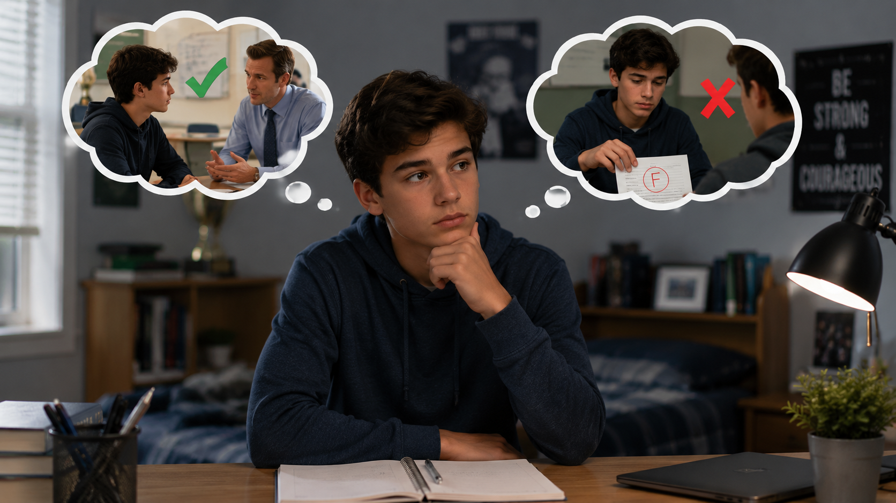
Principles That Protect Freedom
Freedom of Religion
The right to worship as you choose.
Universal Moral Truths
One standard of what is good and bad.
You are free to choose, but you are responsible for your choices.

Slide 12

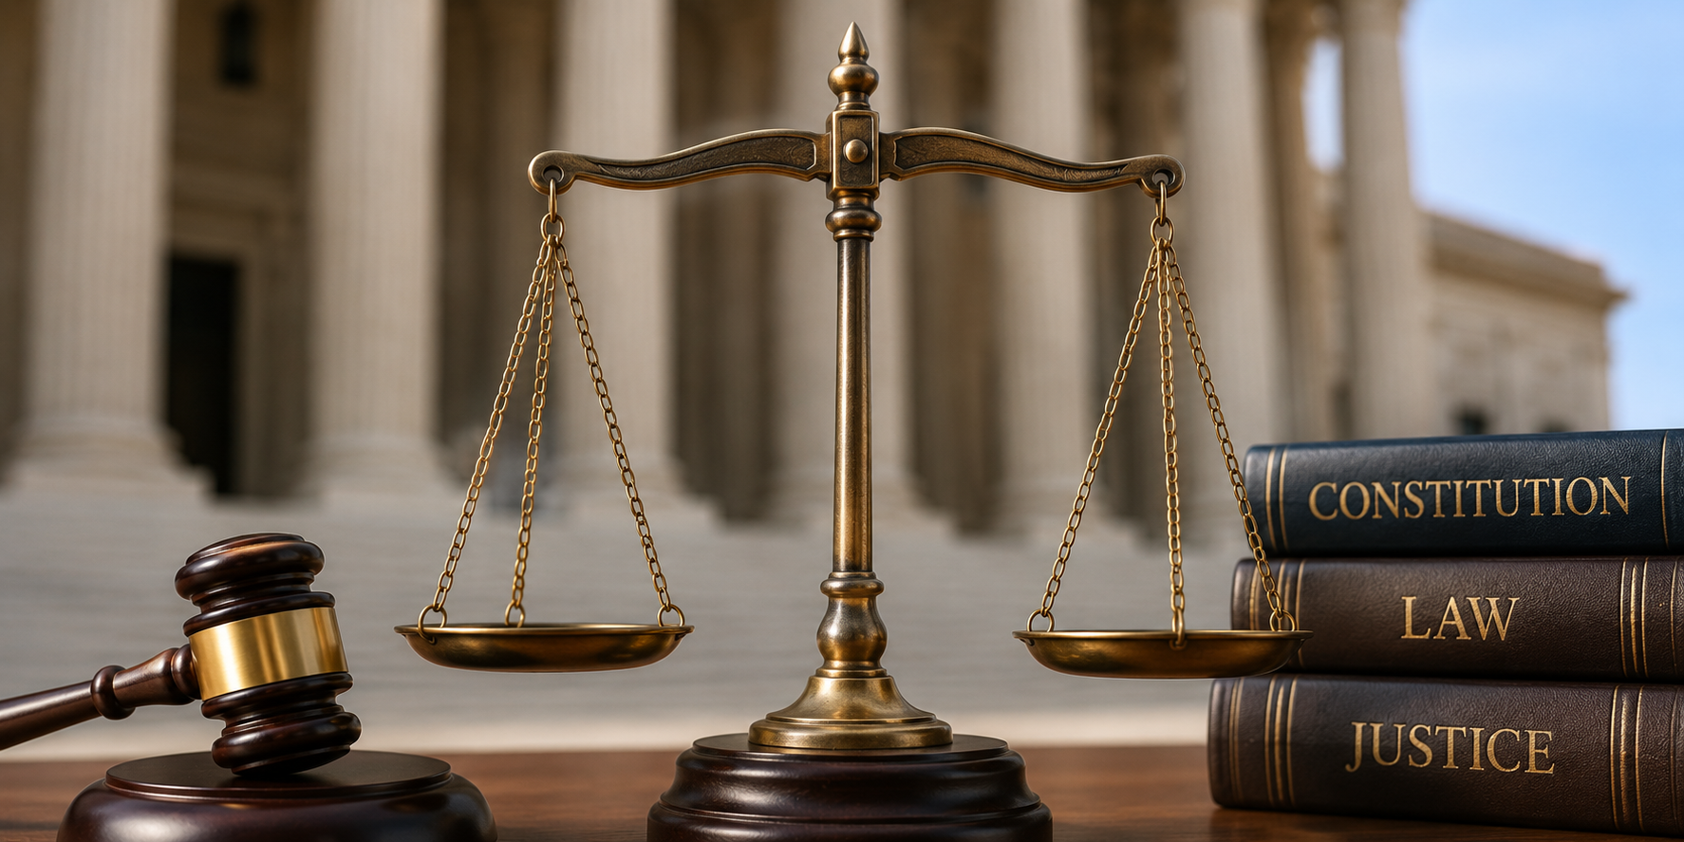
Principles That Protect Freedom
Right to Property
The right to own and control your own property.
Rule of Law
Everyone obeys the law, including government leaders.

Slide 13
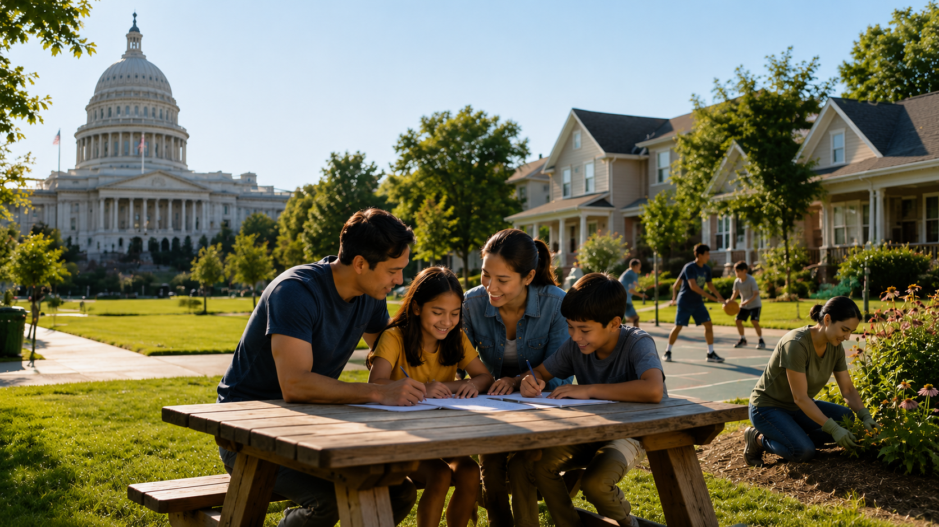
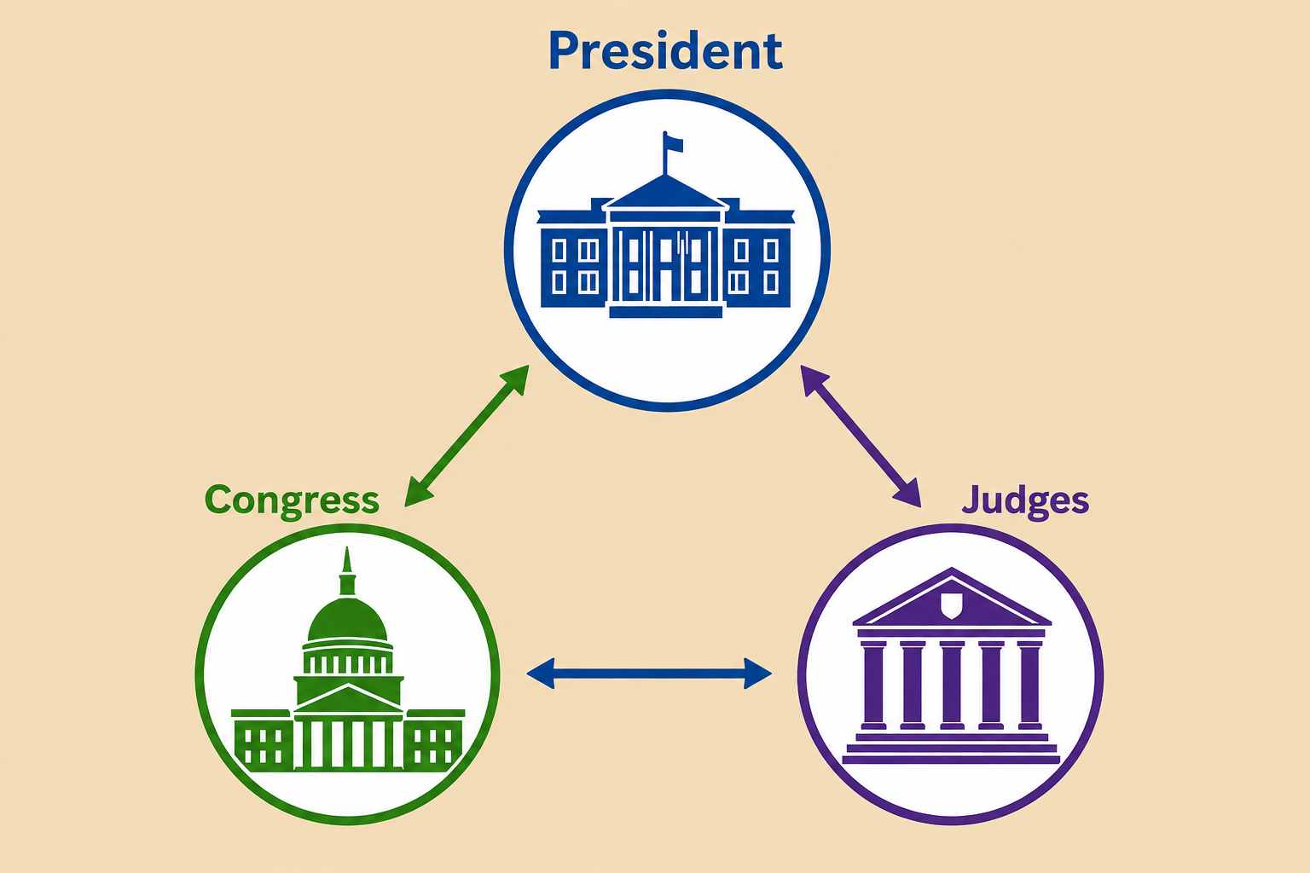
Principles That Protect Freedom
Limited Government
Strong enough to protect rights but limited enough to stay free. We should solve problems at the lowest level.
Separation of Powers (Checks and Balances)
Three branches of government: Executive, Legislative, and Judicial. Each one has different responsibilities and can limit the power of the others.

Slide 14
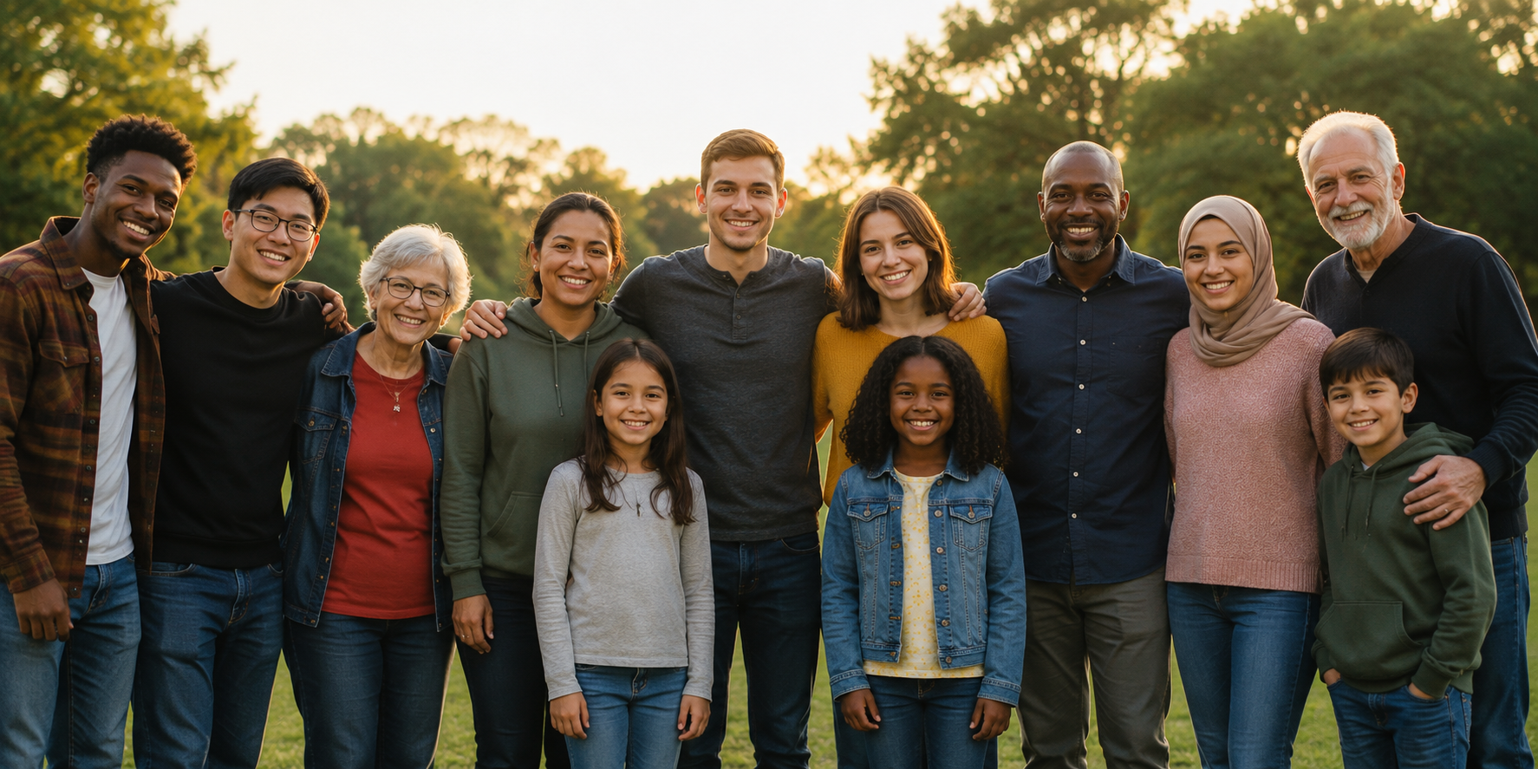

Principles That Protect Freedom
Equal Worth
Everyone has equal worth and has the same rights, regardless of their talents or situation.
Equal Rights, But Not Equal Results
You can pursue your own goals.
You are treated equally, but if you work hard, you may succeed more than others.

Slide 15
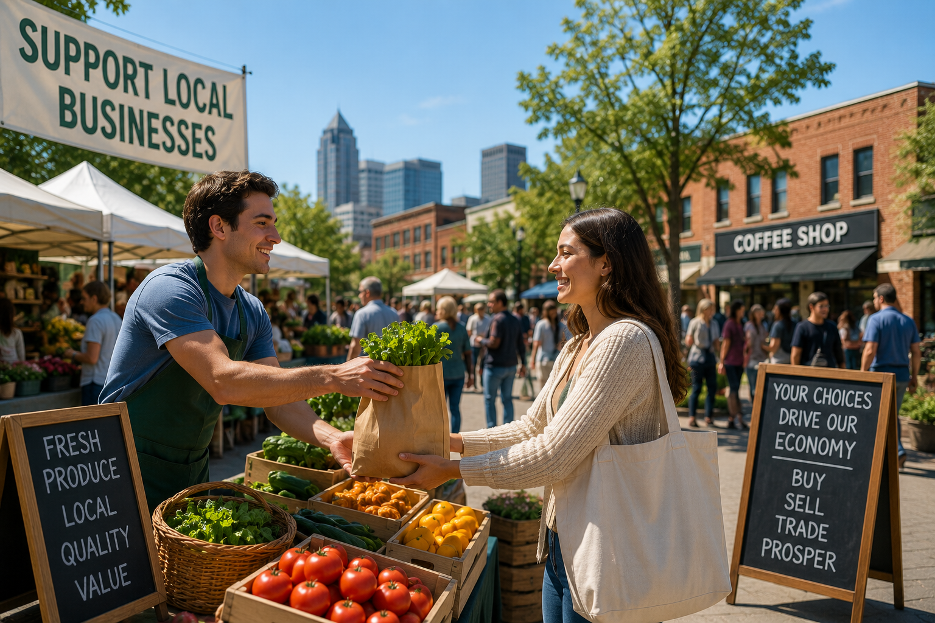
Principles That Protect Freedom
Capitalism and Free Markets
Freedom to make your own choices. Economic competition encourages people to work hard, be creative, and solve problems.

Slide 16
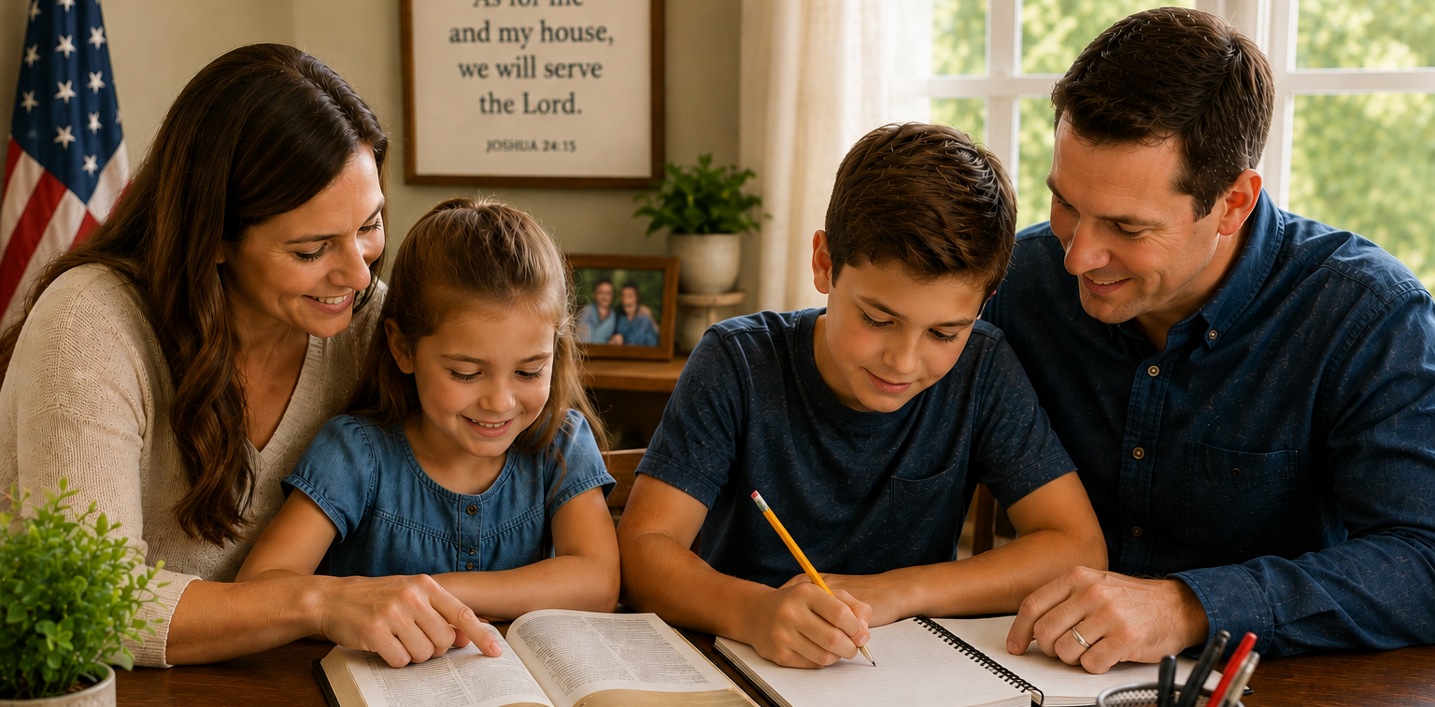
What We Can Do
What We Can Do
Study the scriptures and the Constitution.
Learn correct principles in the home.
Respect the rights of others.
Participate in society.
Defend religious liberty.
Live the gospel.

